Slide 1



ElectriSim
Yassine, Adam, Kee, Gio

Slide 2
User stories
Start menu
List of components
The Builder
Simulation controls
Feedback
Graphs
Parameters
Quit functionality
Saving functionality
Loading functionality
Edit
View
Settings

Slide 3
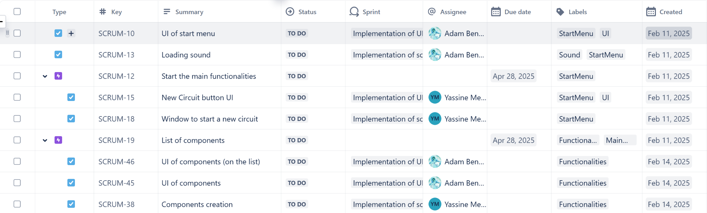
Tasks/User Stories

Slide 4
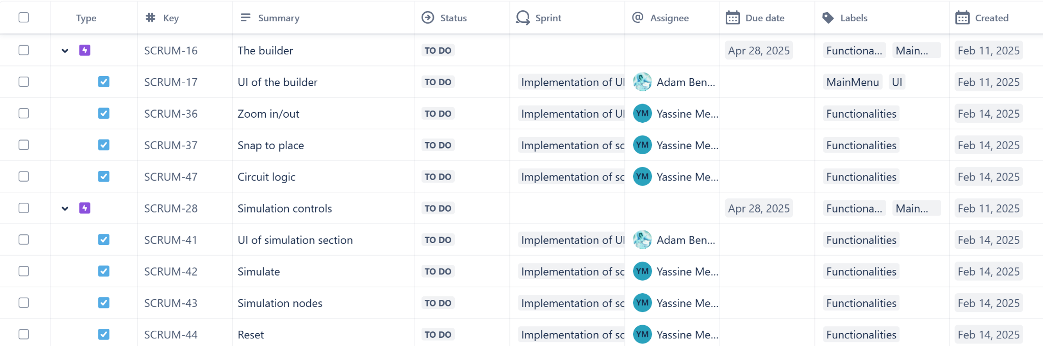
Tasks/User Stories

Slide 5
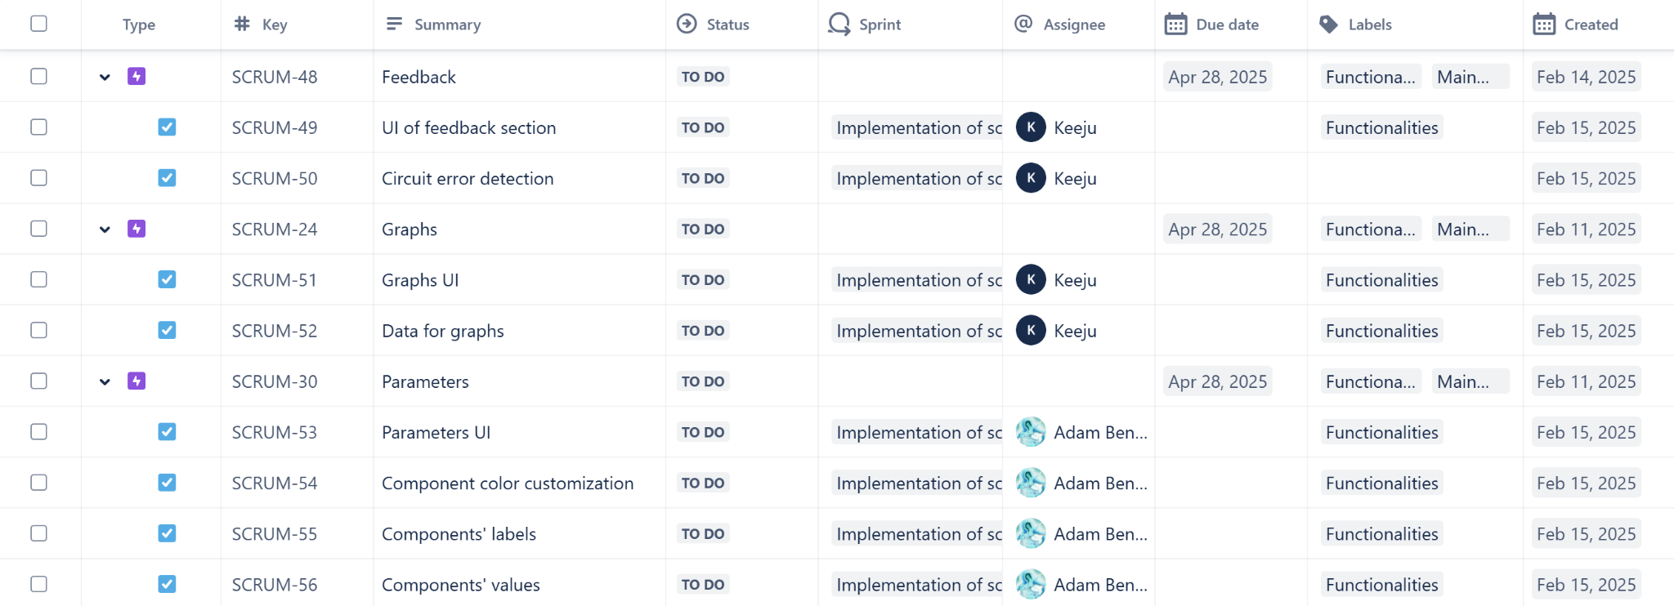
Tasks/User Stories

Slide 6
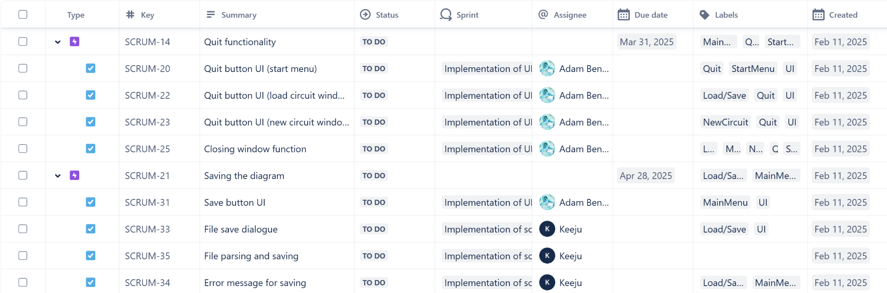
Tasks/User Stories

Slide 7
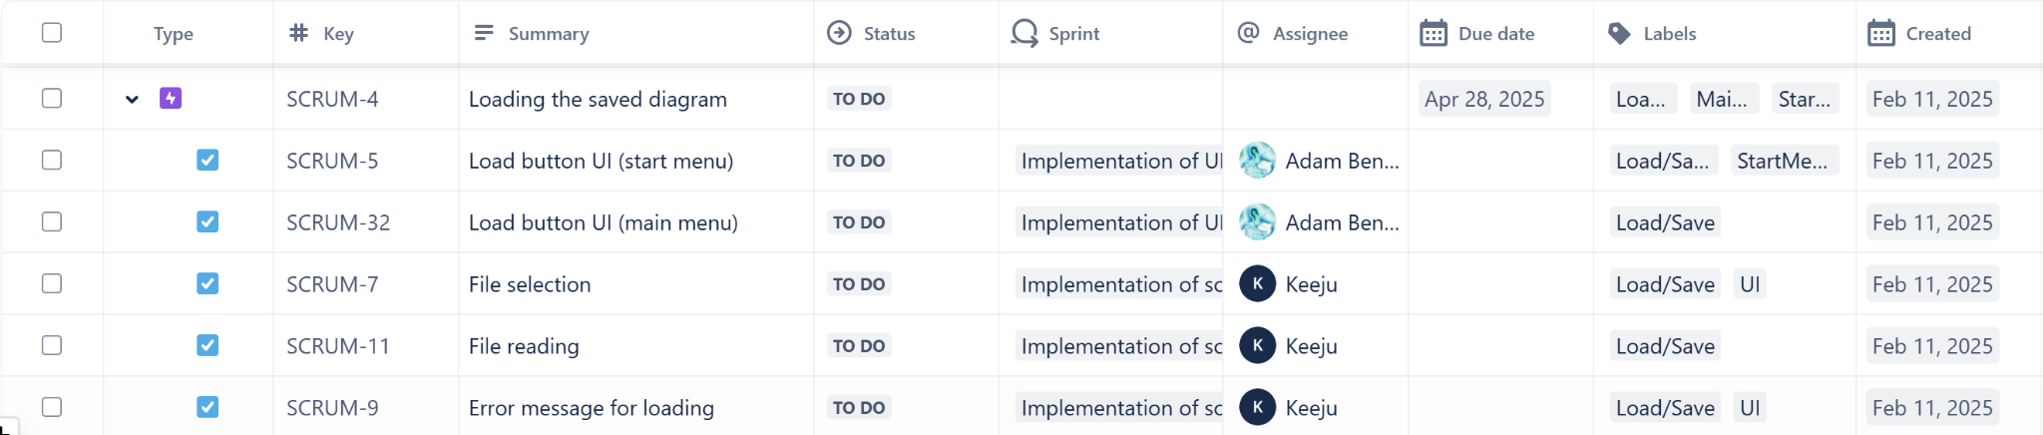
Tasks/User Stories

Slide 8
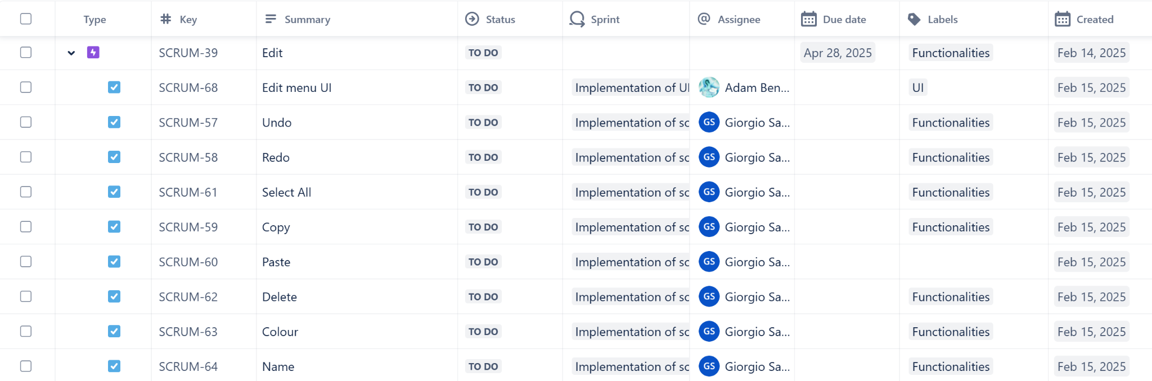
Tasks/User Stories

Slide 9
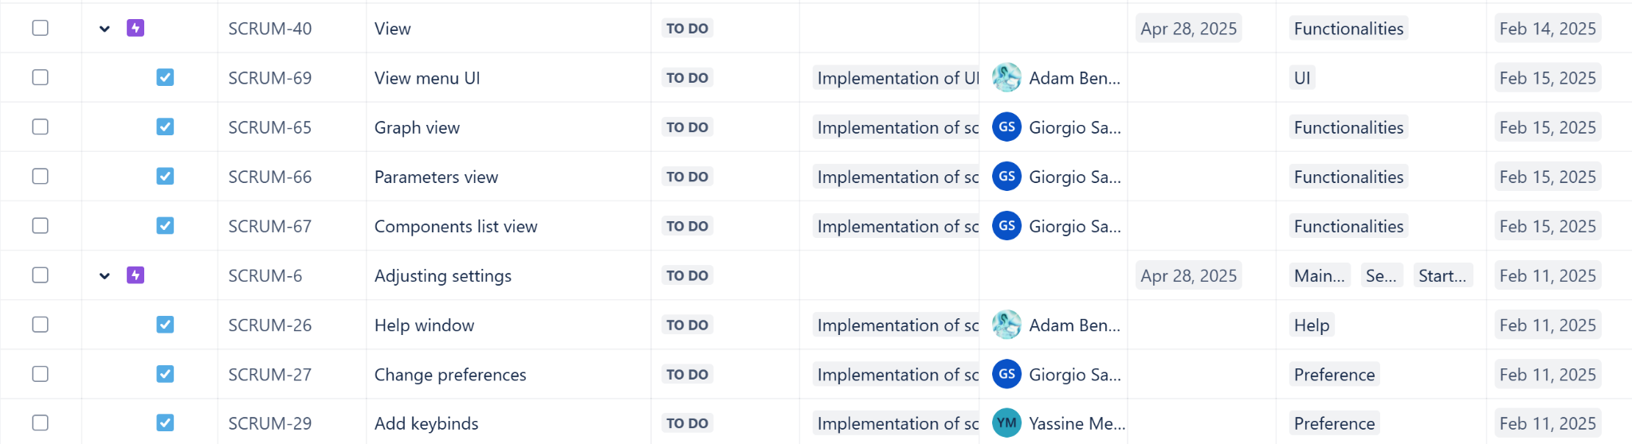
Tasks/User Stories

Slide 10
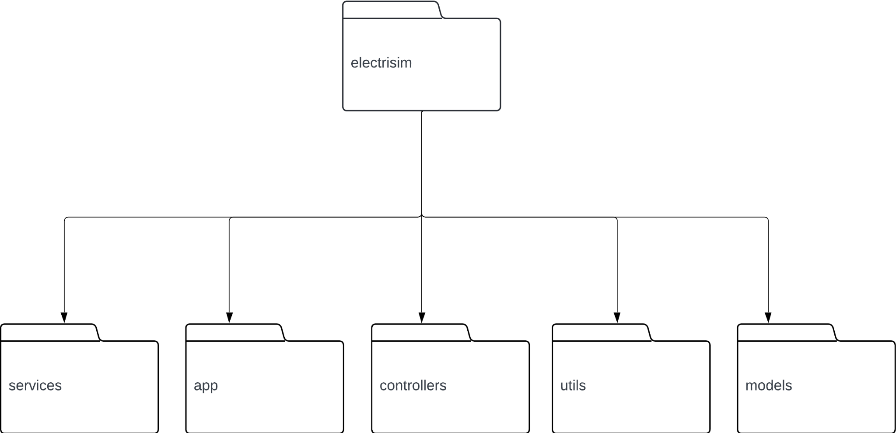
Diagram - Main

Slide 11
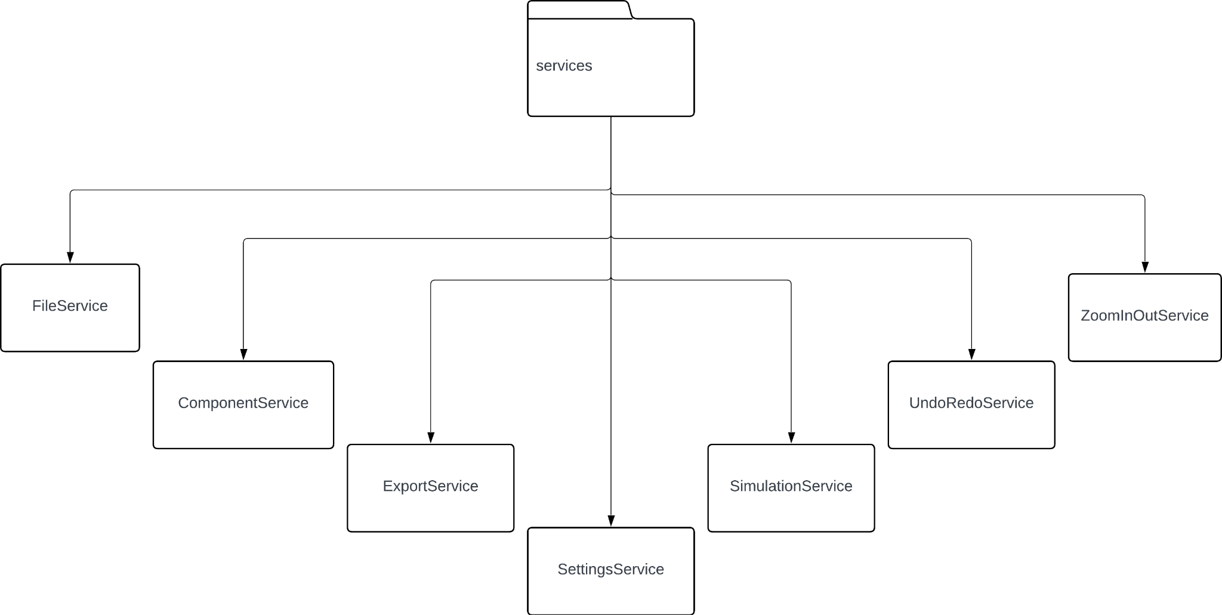
Diagram - Services

Slide 12
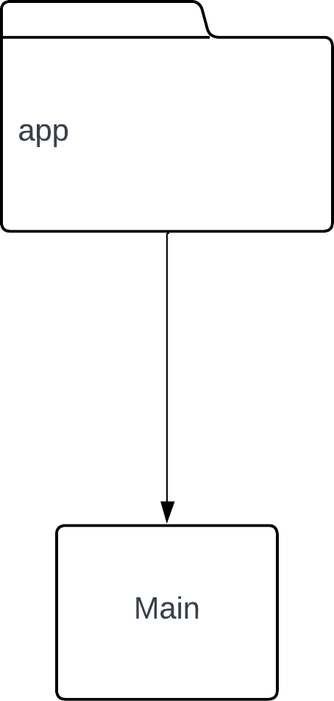
Diagram - App

Slide 13
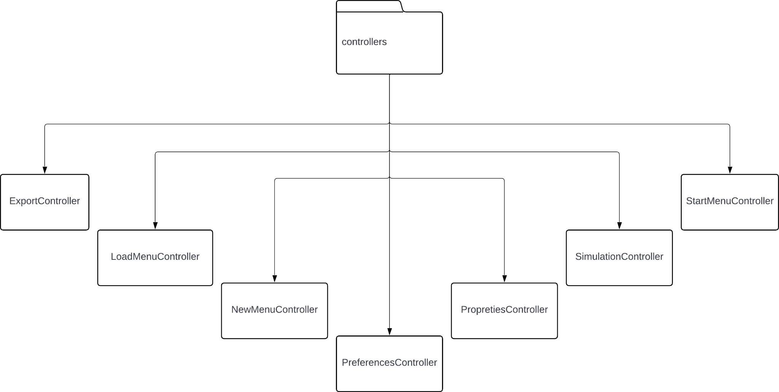
Diagram - Controllers

Slide 14
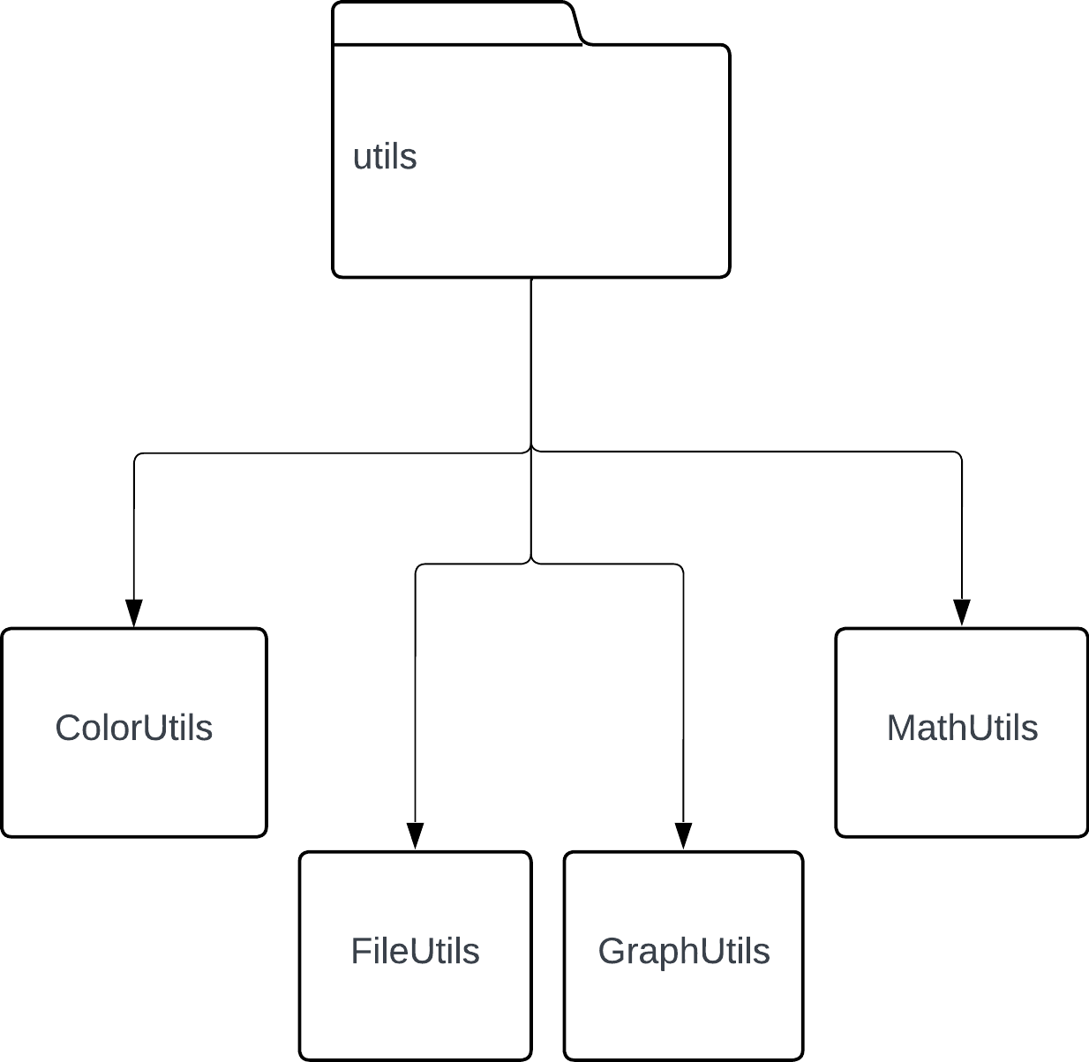
Diagram - Utils

Slide 15
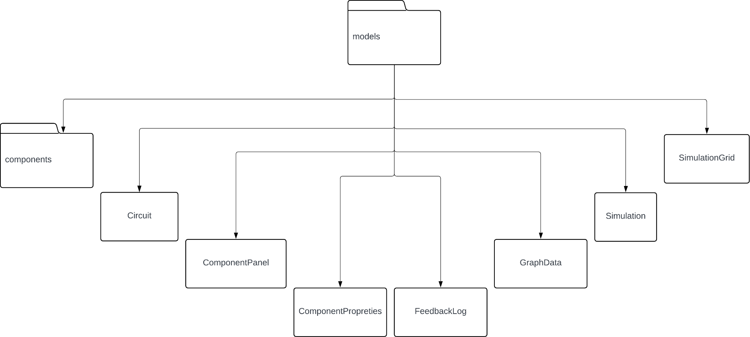
Diagram - Models

Slide 16
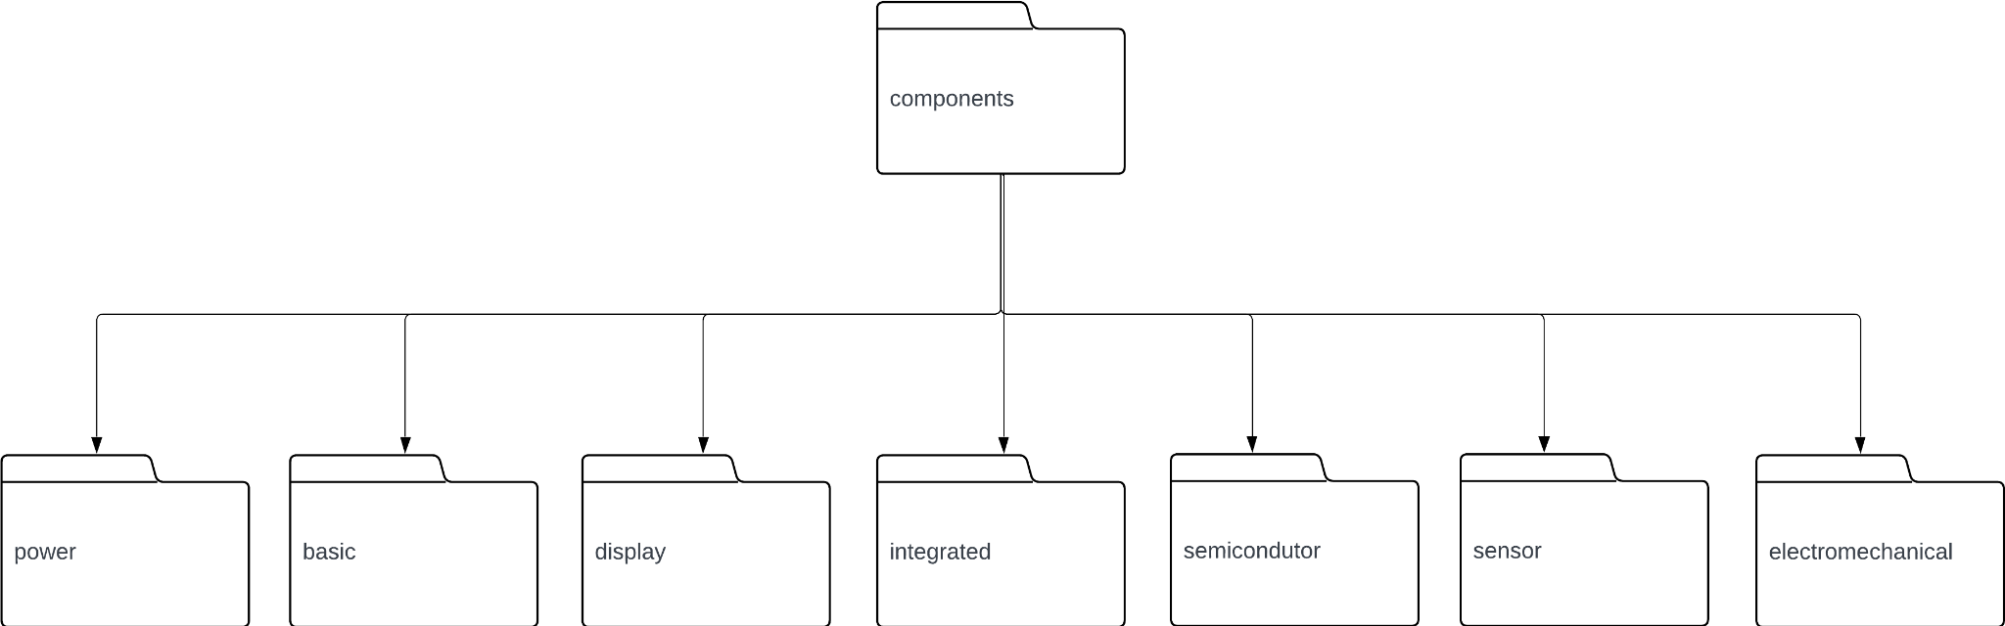
Diagram - Models/Components

Slide 17
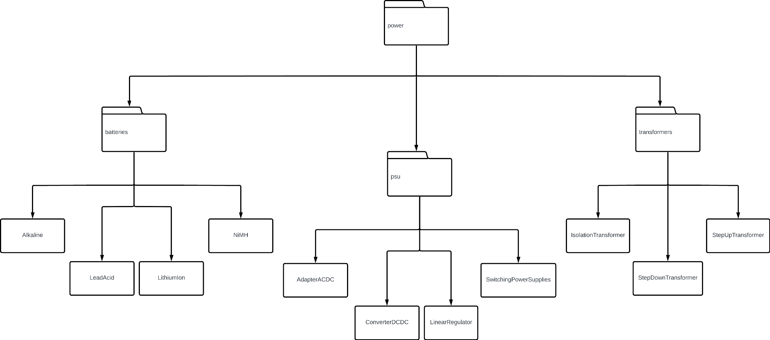
Diagram - Components/Power

Slide 18
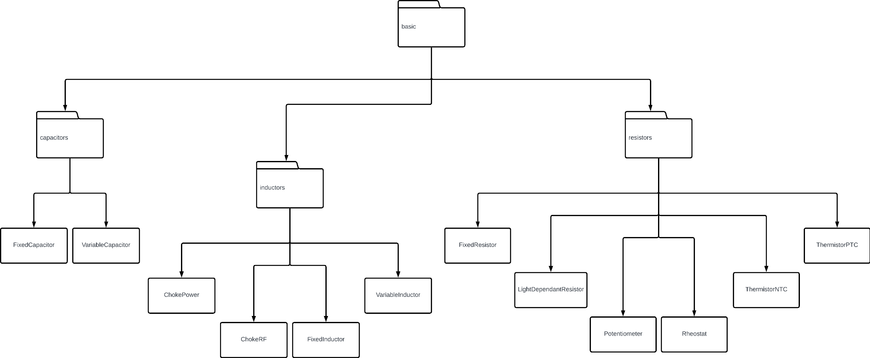
Diagram - Components/Basic

Slide 19
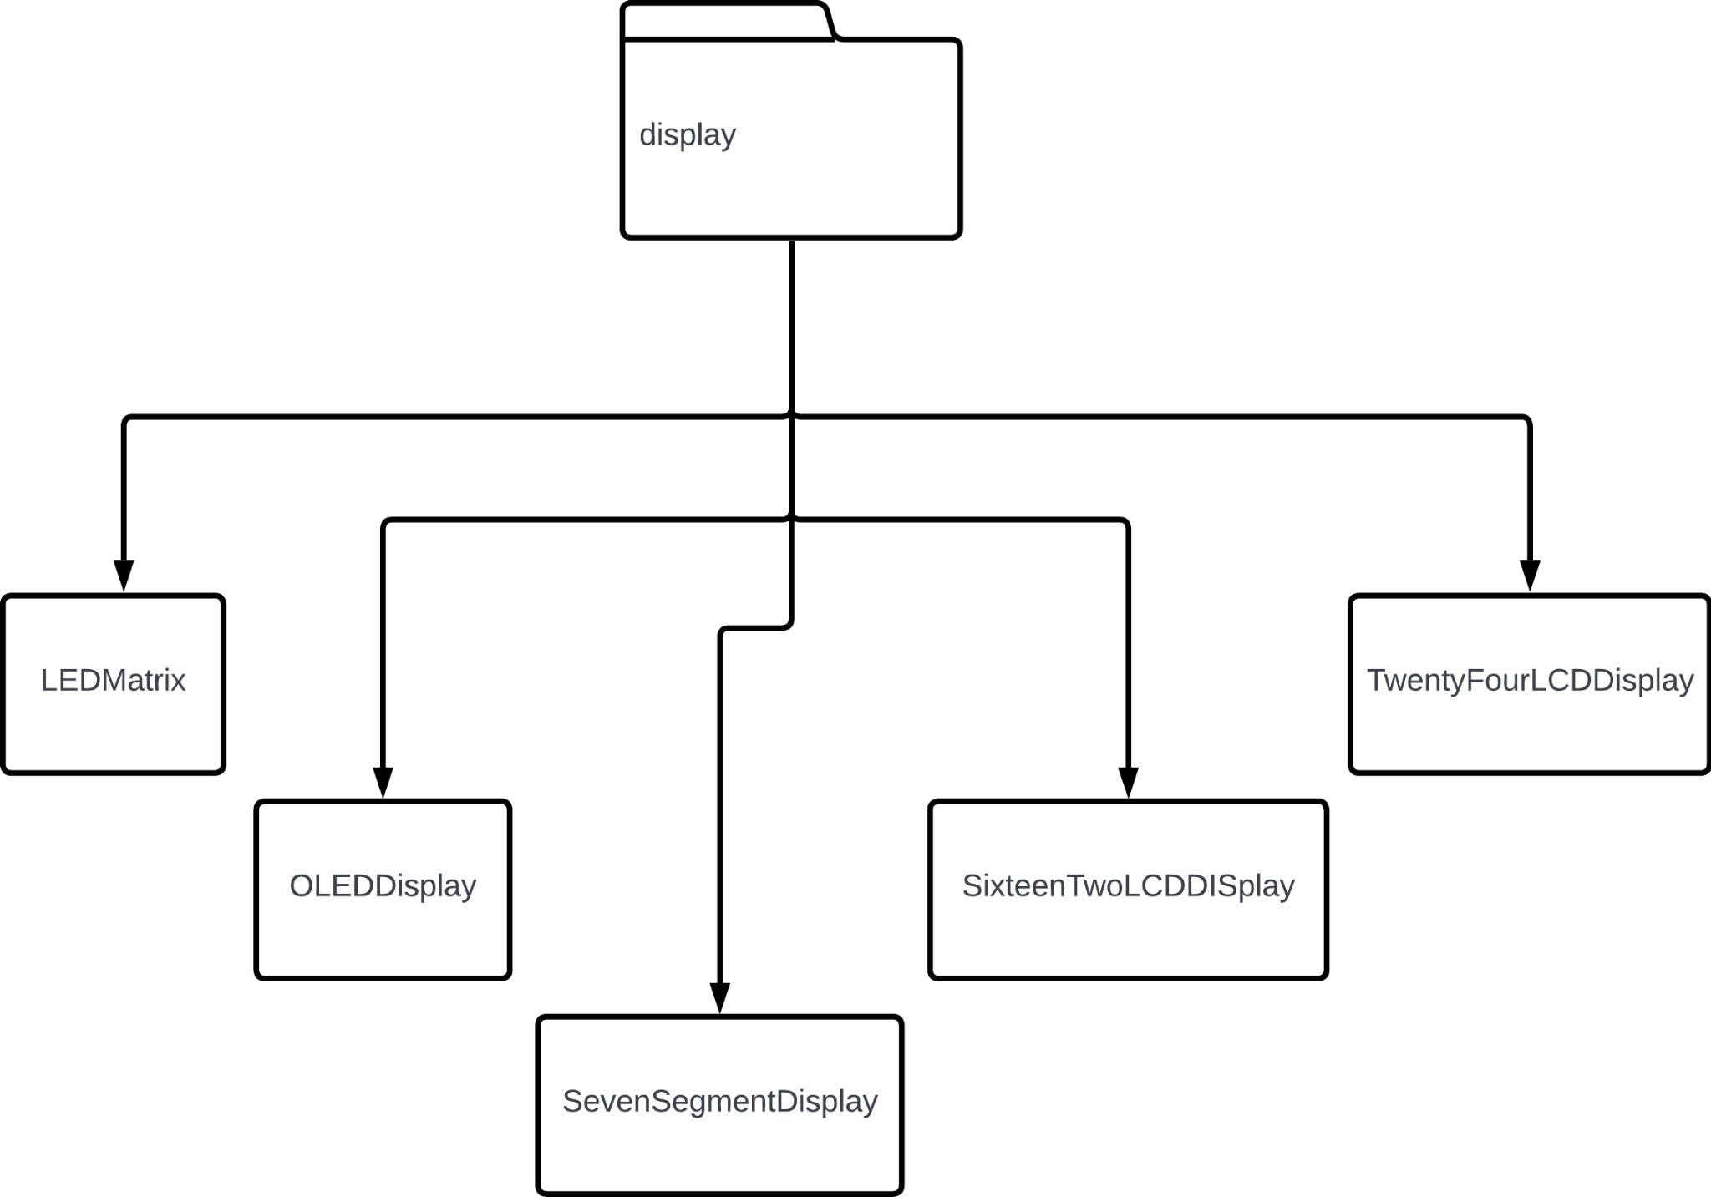
Diagram - Components/Display

Slide 20
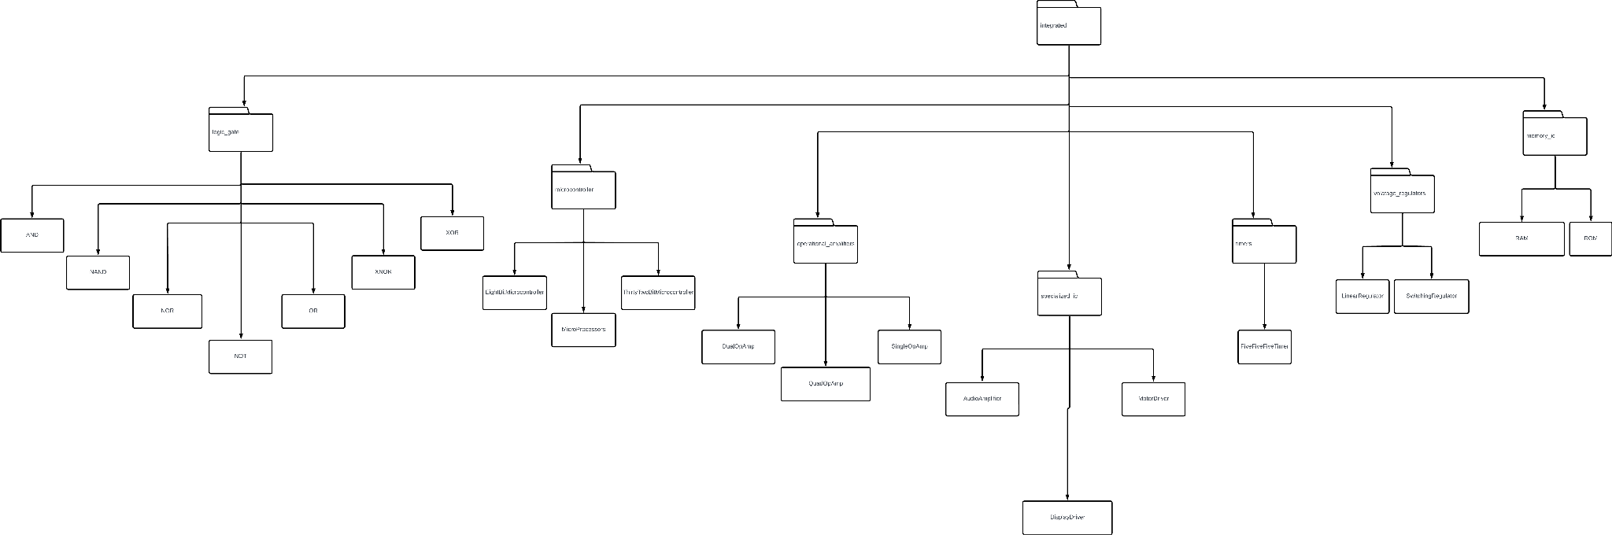
Diagram - Components/Integrated

Slide 21
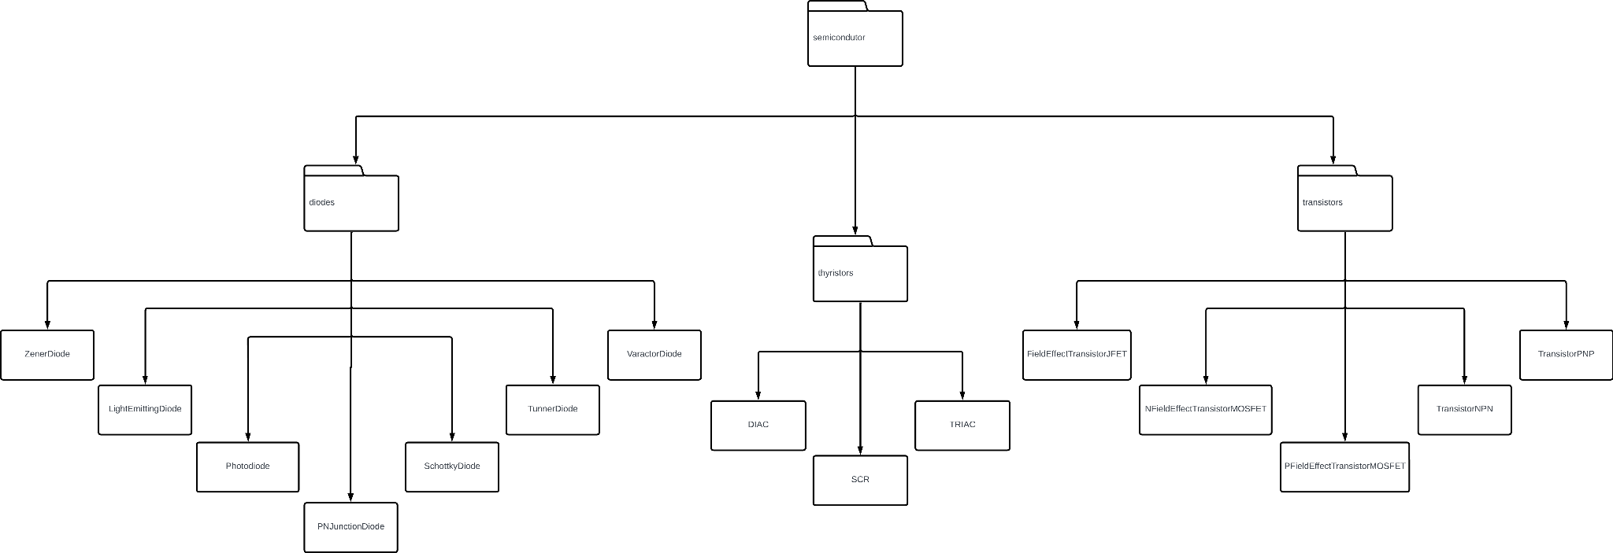
Diagram - Components/Semiconductor

Slide 22
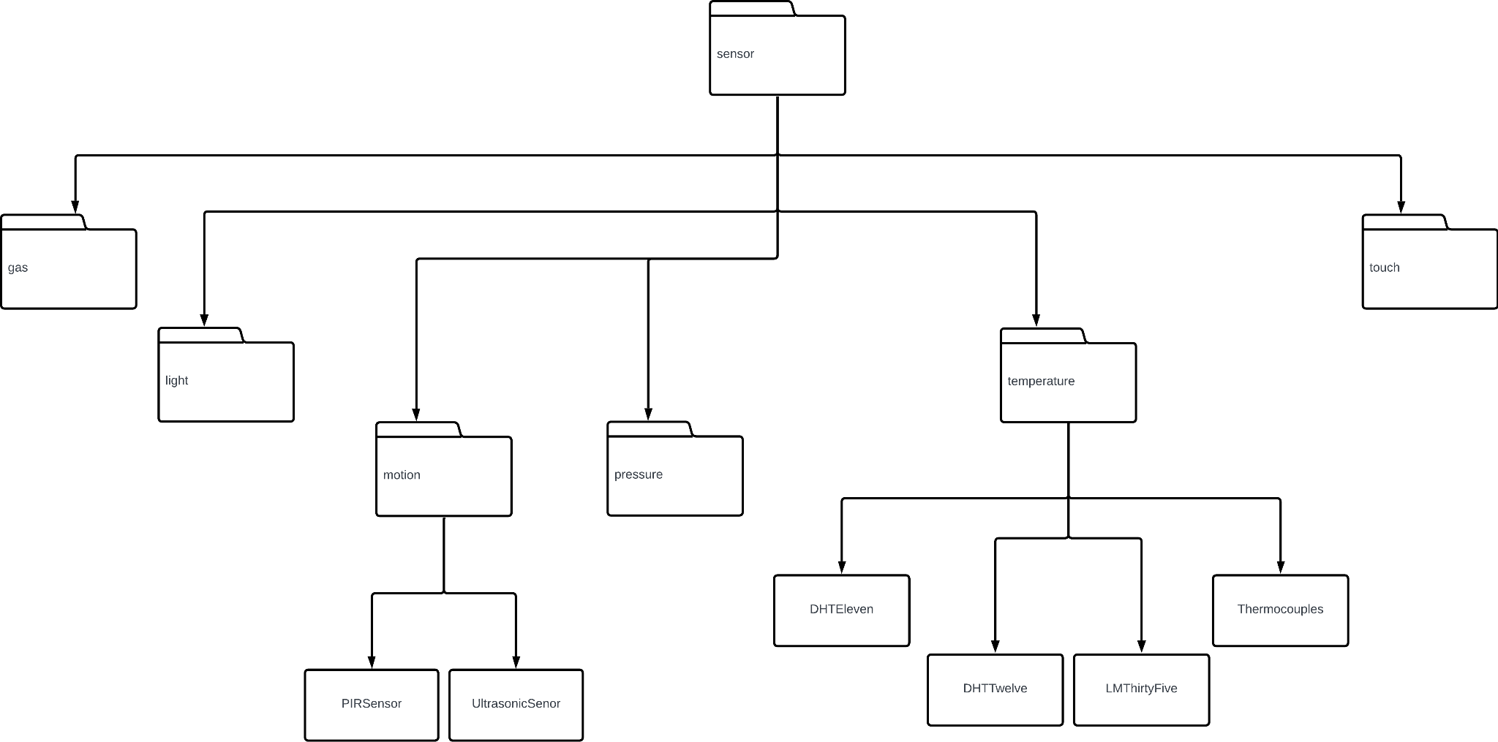
Diagram - Components/Sensor

Slide 23
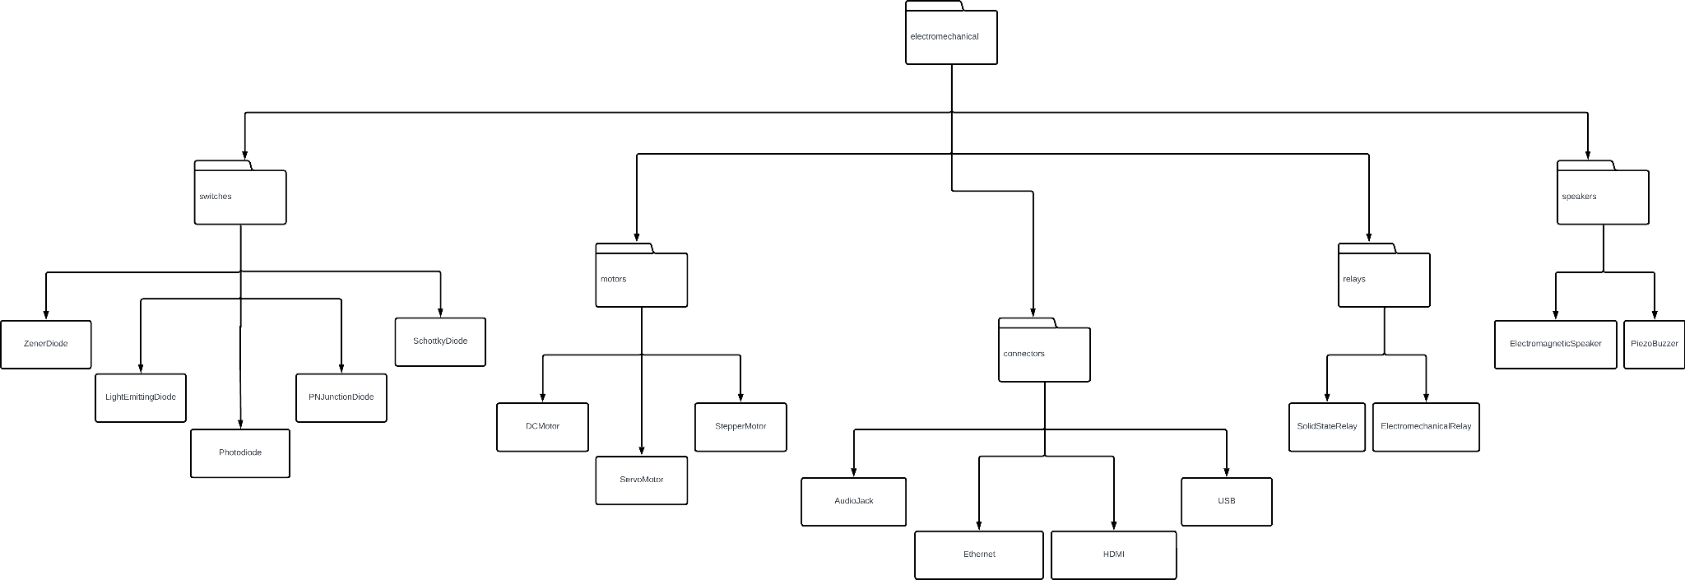
Diagram - Components/Electromechanical

Slide 24
Input / Output Data Grid
Input | Process/Action | Output
User Clicks “New Circuit” | Initialize a new circuit workspace | Display empty workspace ready for circuit design
User Clicks “Quit” | Terminate application | Program closes
User drags a resistor into workspace | Add resistor component to the canvas | Resistor icon appears at the dropped location
User changes resistor value (Ohms) | Update resistor parameters | Updated resistance value is reflected
User connects components with a wire | Snap components together based on grid lines | Wire appears connecting the components
User clicks “Delete” on component | Remove selected component | Component disappears from workspace

Slide 25
Input / Output Data Grid
Input | Process/Action | Output
User clicks "Simulate" | Start circuit simulation | Display current, voltage, and resistance values
User clicks "Reset" | Clear circuit components | Clears canvas to empty workspace
User clicks "Add Sim Node" | Add a node to the circuit | Node is added at the specified location
User clicks "Undo" | Revert last action | Undo the most recent action
User clicks "Redo" | Reapply the reverted action | Reapplies the last action
User clicks "Save" | Save current circuit configuration to file | File saved with user-defined name

Slide 26
Input / Output Data Grid
Input | Process/Action | Output
User clicks "Export" | Export circuit as .json , .png etc… | Export file in chosen format
User changes theme to dark/light mode | Adjust interface appearance | Switch between dark and light theme
User zooms in/out with scroll pane | Adjust scale to see better | Grid lines and components are adjusted
User clicks "Help" | Display help info | Show instructions and info
User inputs incorrect voltage value | Validate input | Error message: "Not Enough Voltage"
User clicks "Maximize - Minimize Graph" | Adjust Graph size | Graph expands/shrinks

Slide 27
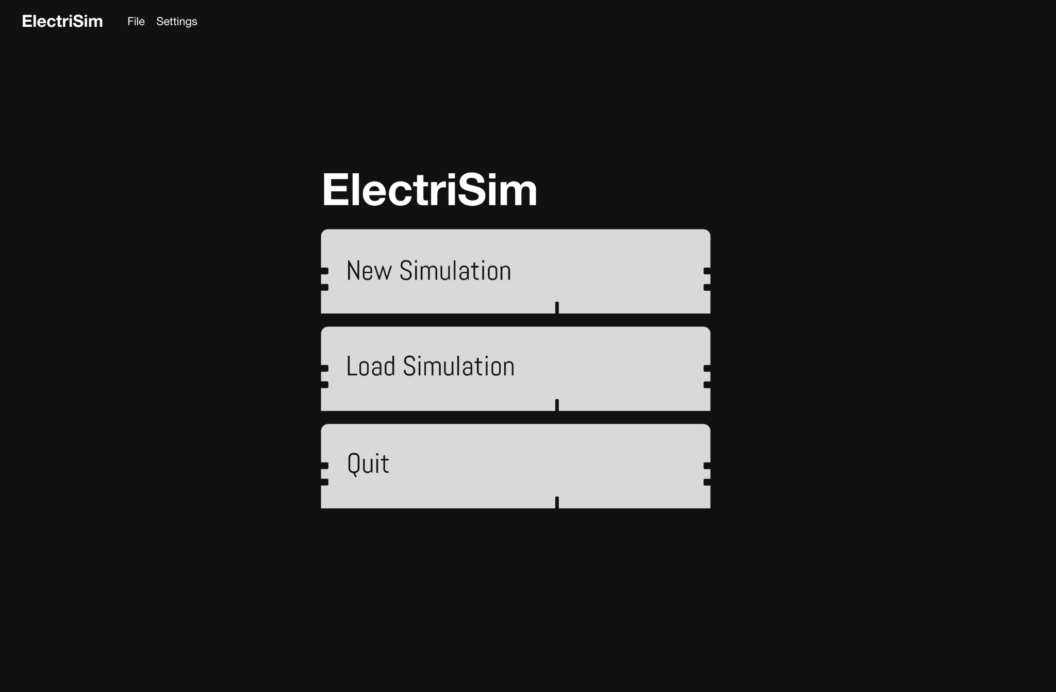

Slide 28
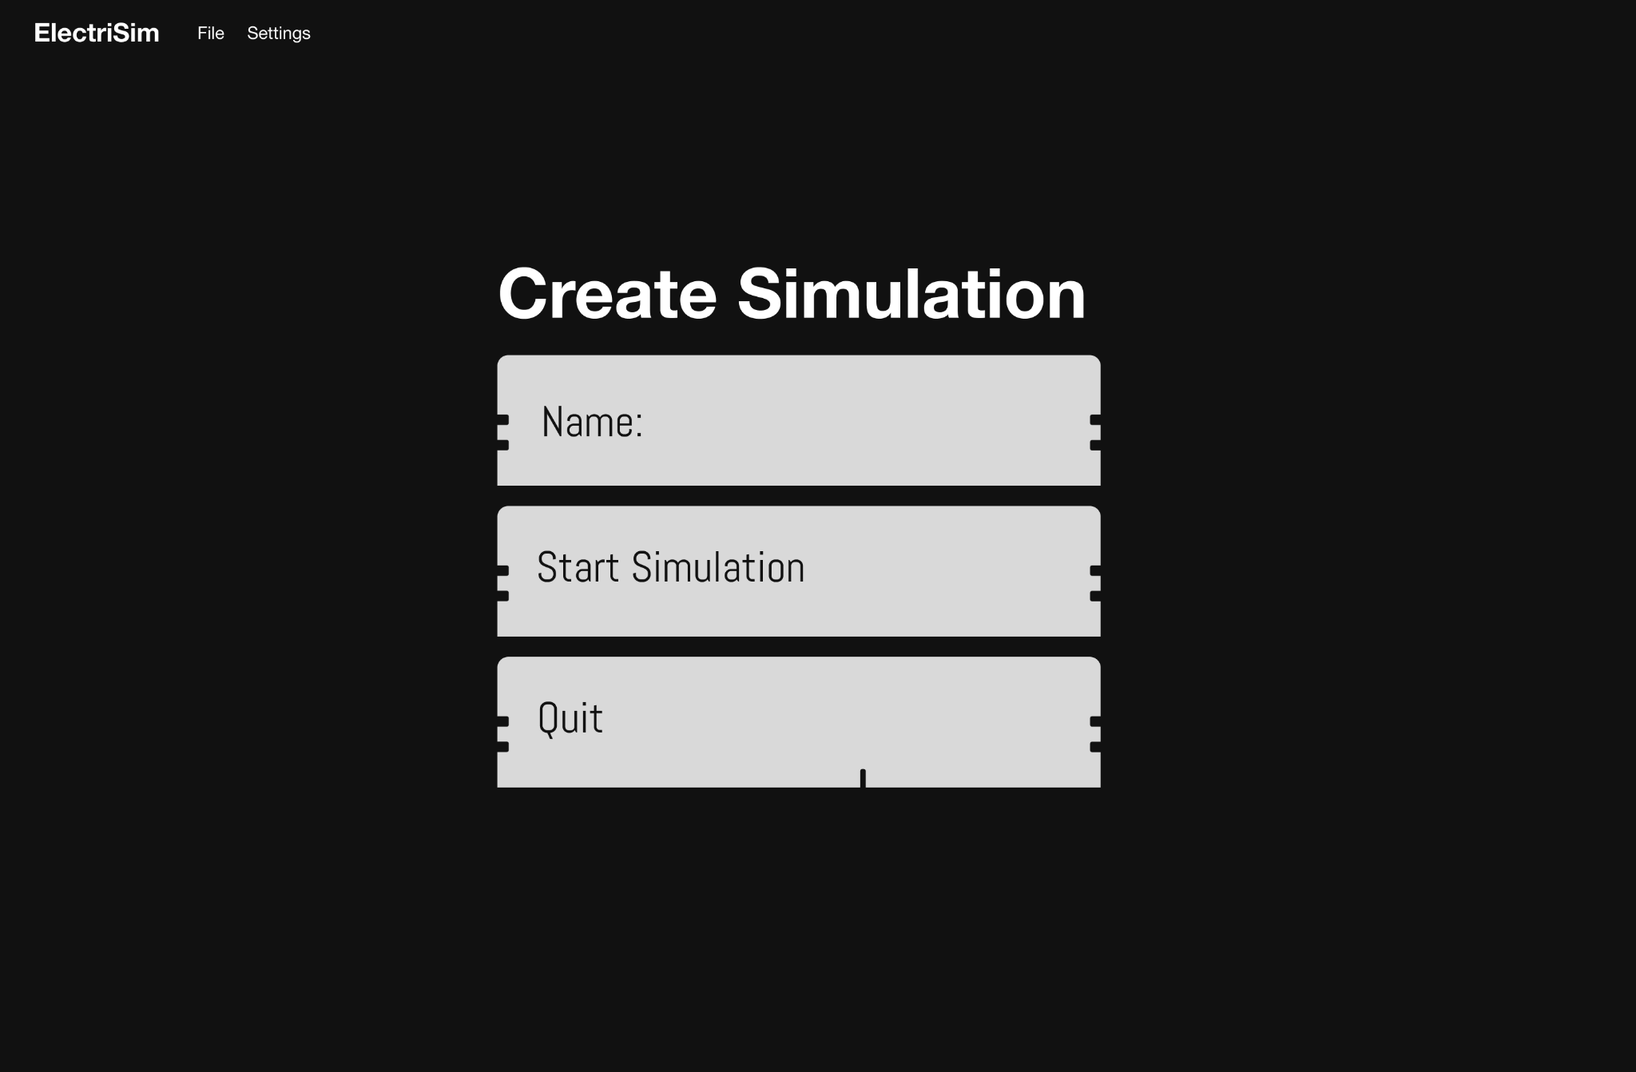

Slide 29
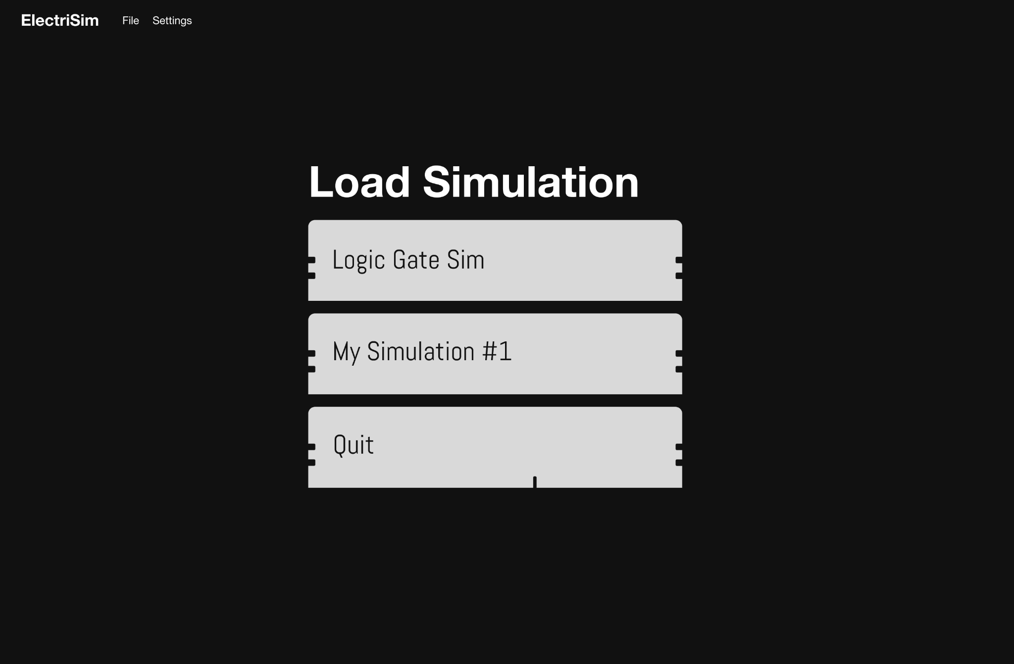

Slide 30
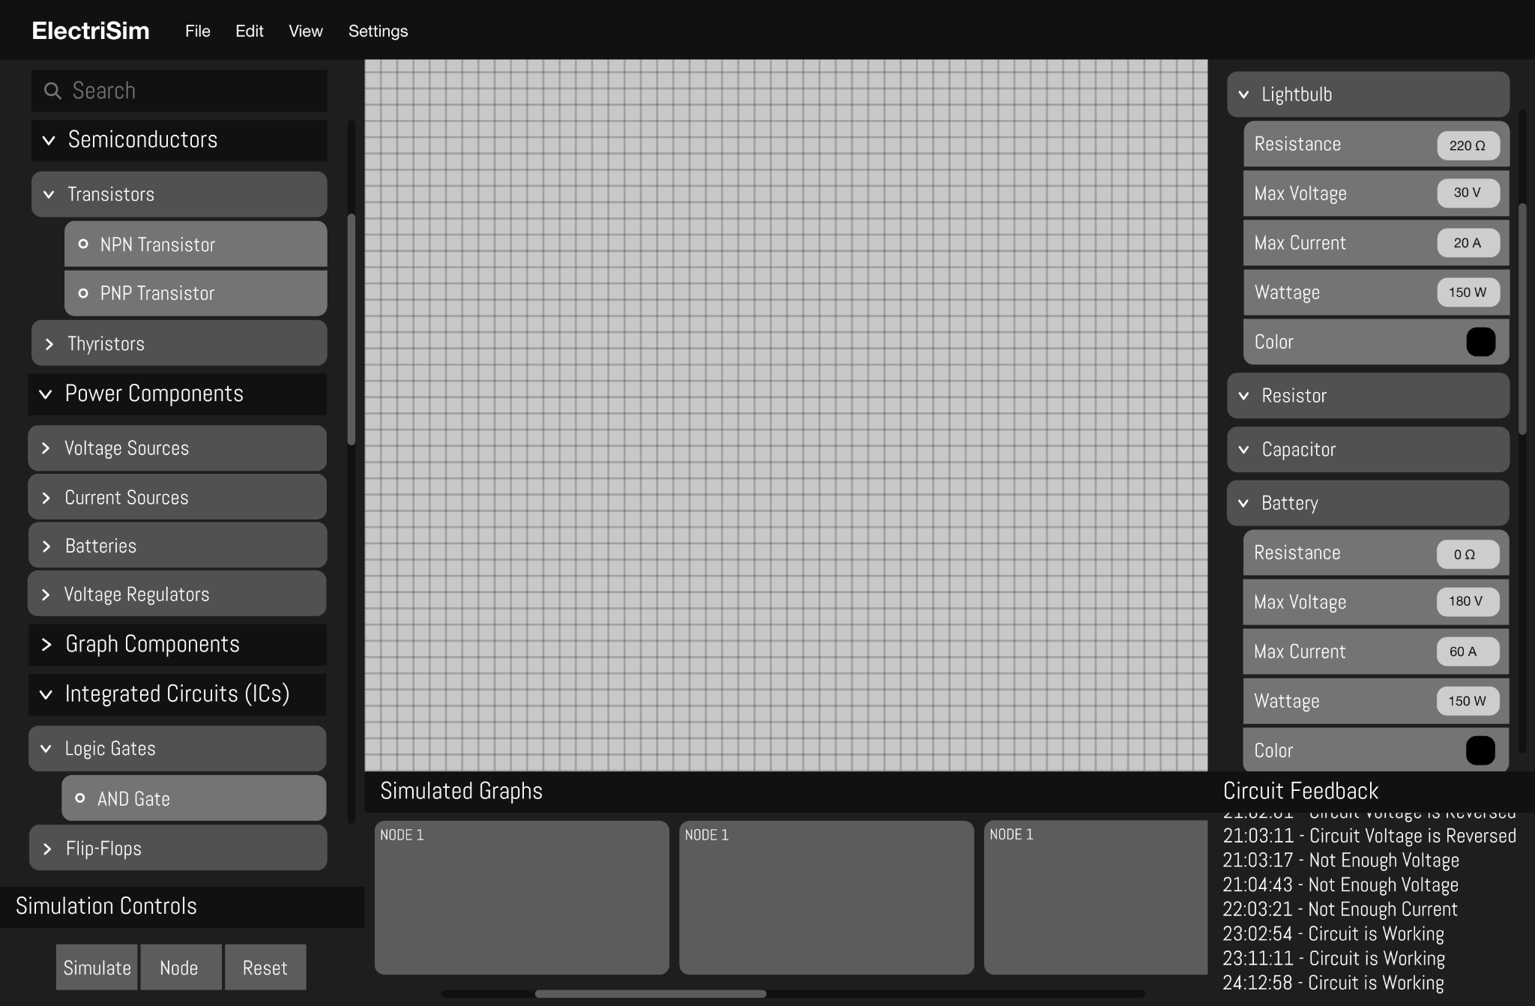

Slide 31
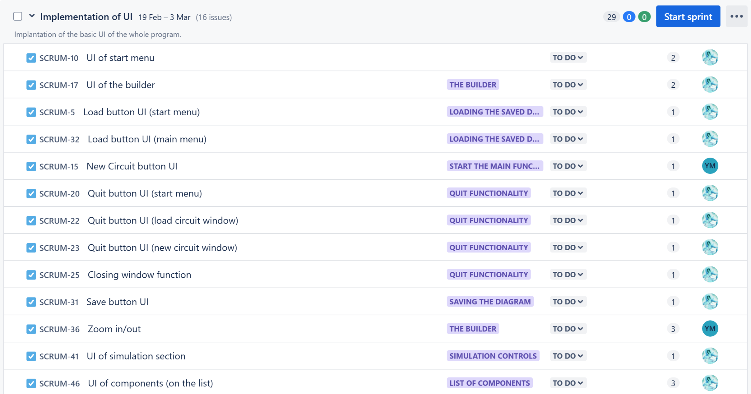
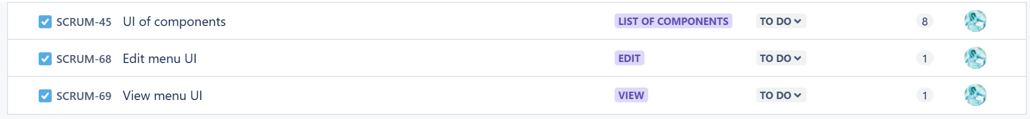
Sprints: Implementation of the UI

Slide 32
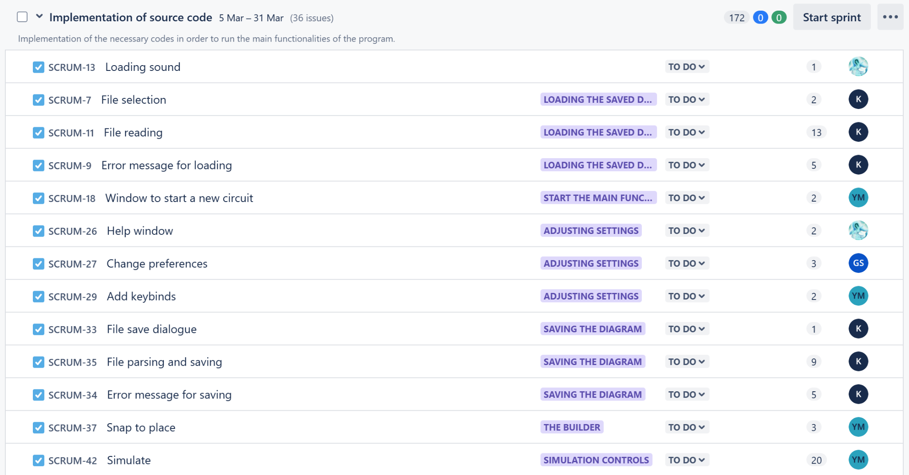
Sprints: Source Code

Slide 33
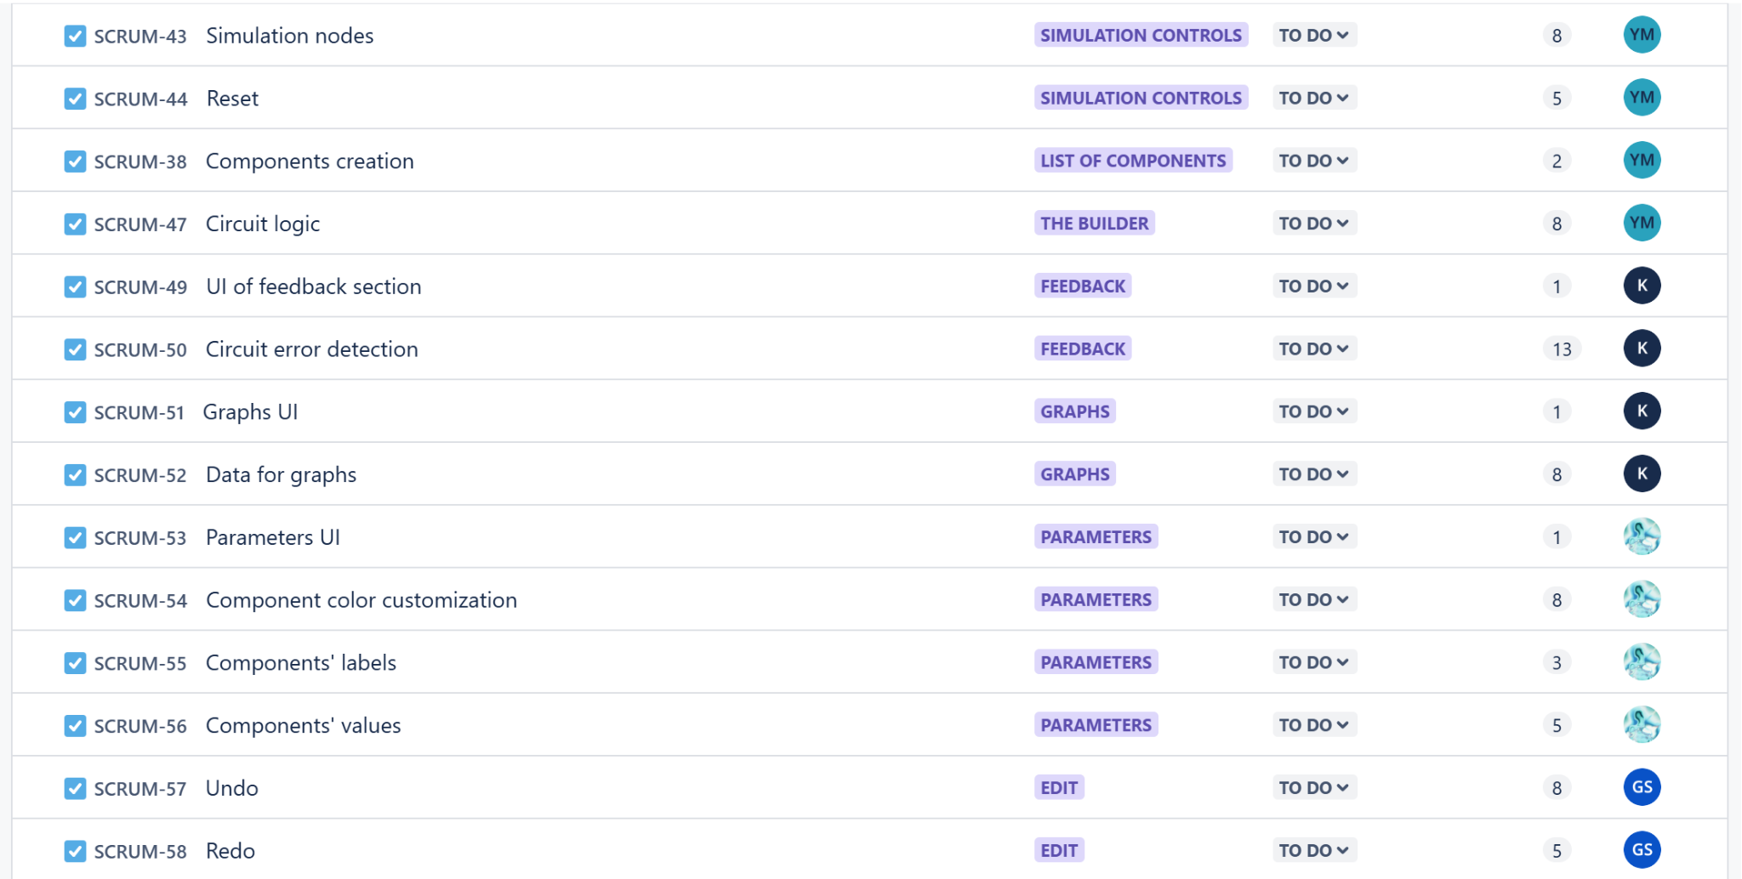
Sprints: Source Code

Slide 34
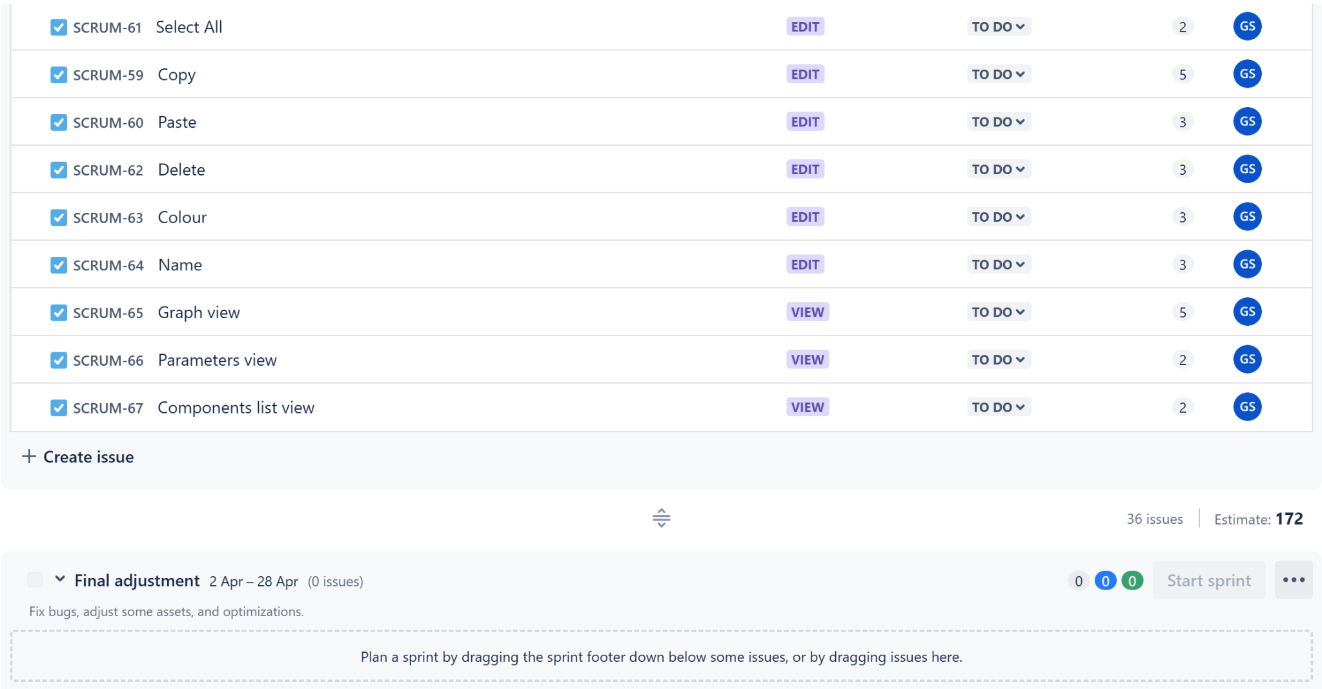
Sprints: Source Code/Final adjustments

Slide 35


THANKS!

